Slide 1
Lesson 6: Visualization

Slide 2
Overview
When dealing with a set of data, often the first thing you’ll want to do is get a sense for how the variables are distributed.
In today’s class we will give a brief introduction to some of the tools in ‘seaborn for examining univariate and bivariate distributions.

Slide 3
Visualizing the distribution of a dataset
Data visualization is a fancy word which essentially comprises only of these 3 basic steps:
Importing the required libraries (such as matplotlib, seaborn etc)
Getting the data ready
Reading a CSV file or a JSON data
Creating a dataframe.
Graphical representation
Choose the type of plot

Slide 4
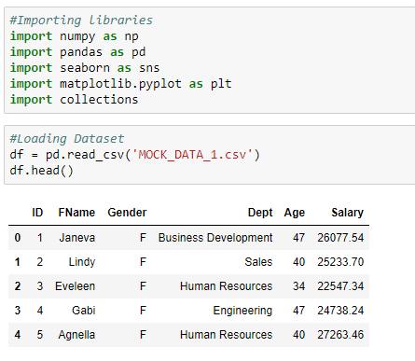
Importing the required libraries and Loading the data

Slide 5
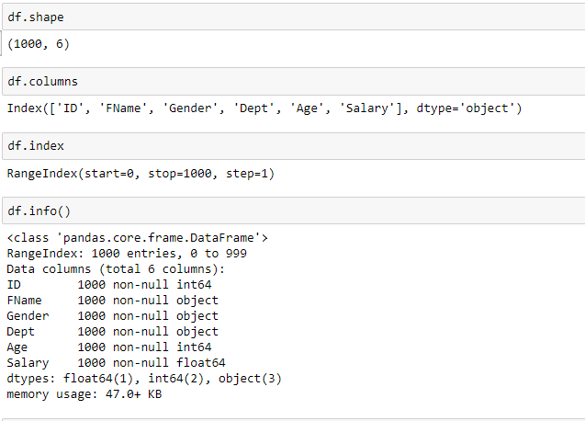
Getting to know your data - 1

Slide 6
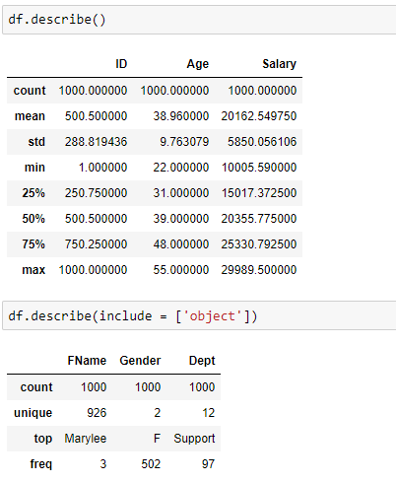
Getting to know your data - 2

Slide 7
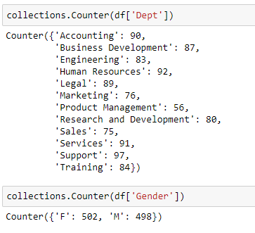
Getting to know your data - 3

Slide 8
Plotting Univariate Plots
In this section we will look at techniques that you can use to understand each attribute independently.
Also we are going to learn about Seaborn, which is a Python visualization library based on matplotlib. It provides a high-level interface for drawing attractive statistical graphics.
The most convenient way to take a quick look at a univariate distribution in seaborn is the distplot() function.
By default, this will draw a histogram and fit a kernel density estimate (KDE).

Slide 9
Histogram & Kernel density estimation
A fast way to get an idea of the distribution of each attribute is to look at histograms.
Histograms group data into bins and provide us a count of the number of observations in each bin.
Like the histogram, the KDE plots encodes the density of observations on one axis with height along the other axis. Learn more about KDE_Plot from here
From the shape of the bins we can quickly get a feeling for whether an attribute is
Skewed or unskewed
Type of distribution.
It can also help us to see possible outliers.

Slide 10
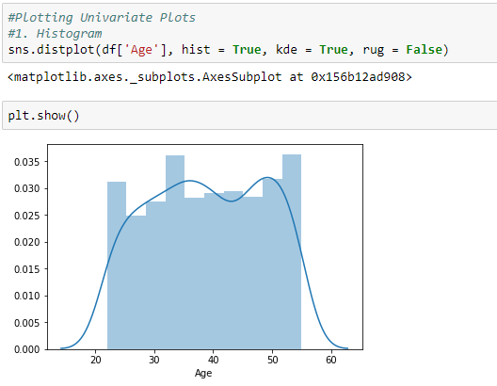
Histogram & Kernel density estimation

Slide 11
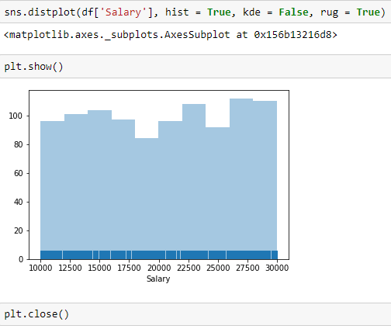
Histogram & Kernel density estimation

Slide 12
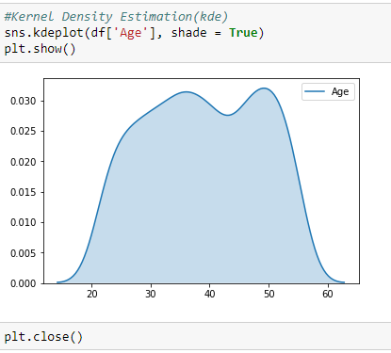
Histogram & Kernel density estimation
We can see that if we use the kdeplot() function in seaborn, we get the same curve.
This function is used by distplot(), but it provides a more direct interface with easier access to other options when you just want the density estimate
The bandwidth (bw) parameter of the KDE controls how tightly the estimation is fit to the data, much like the bin size in a histogram.

Slide 13
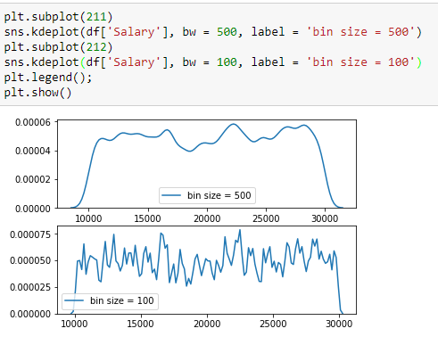
Histogram & Kernel density estimation

Slide 14
Plotting Bivariate Plots
It can also be useful to visualize a bivariate distribution of two variables.
The easiest way to do this in seaborn is to just use the jointplot() function, which creates a multi-panel figure that shows both the bivariate (or joint) relationship between two variables along with the univariate (or marginal) distribution of each on separate axes.

Slide 15
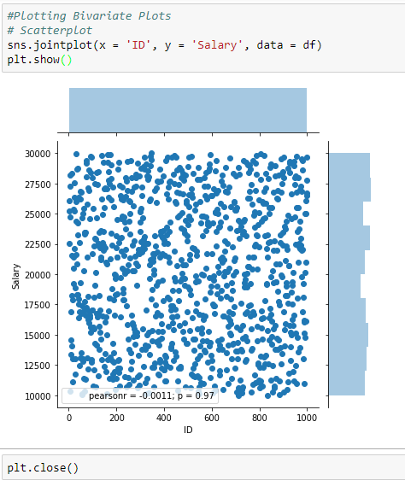
Scatter Chart
The most familiar way to visualize a bivariate distribution is a scatterplot, where each observation is shown with point at the x and y values.

Slide 16
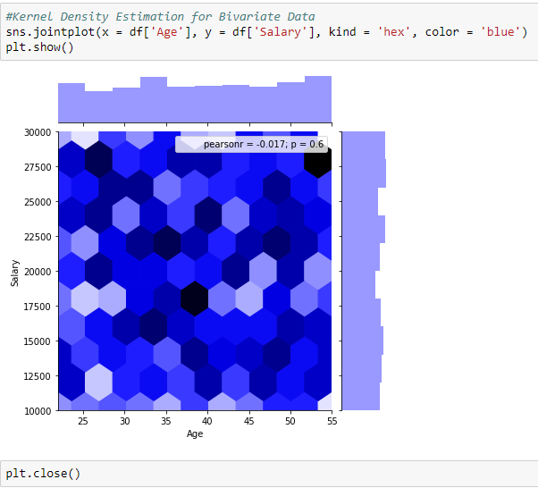
Kernel Density Estimation
It is also possible to use the kernel density estimation procedure described above to visualize a bivariate distribution.
In seaborn, this kind of plot is shown with a contour plot and is available as a style in jointplot()

Slide 17
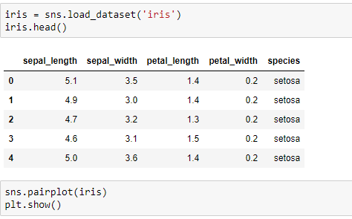
Plotting with categorical data

Slide 18
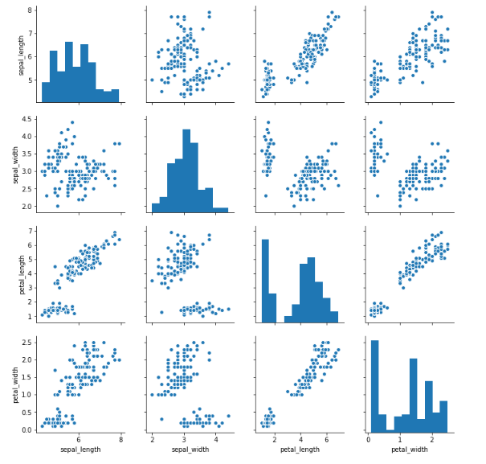

Slide 19
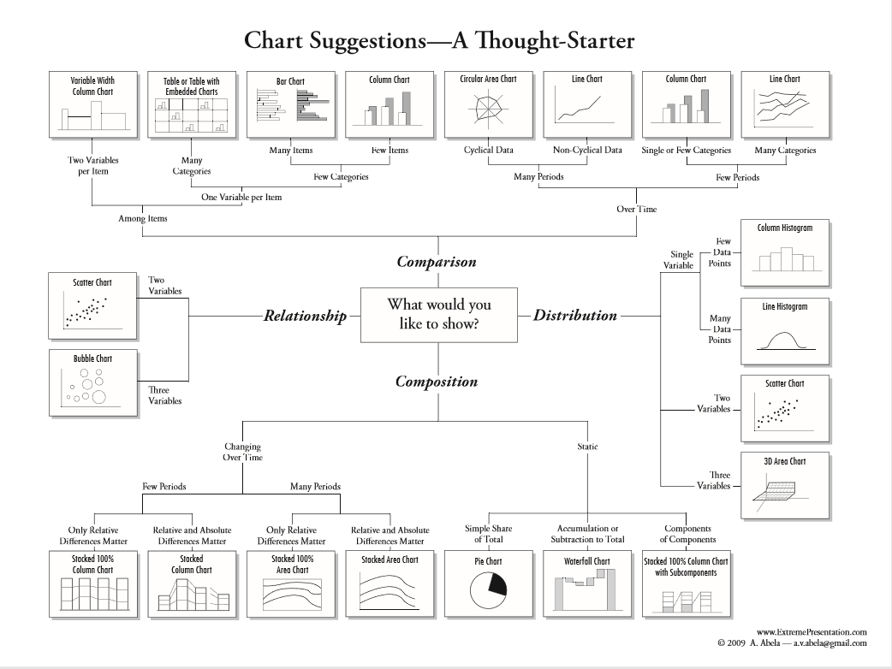

Slide 20
We’ll continue in next class..
Any questions?

